Slide 1


Weather App
Welcome to our interactive weather app! Get accurate and up-to-date weather information for any location worldwide.
by VAIBHAVI SAHU

Slide 2

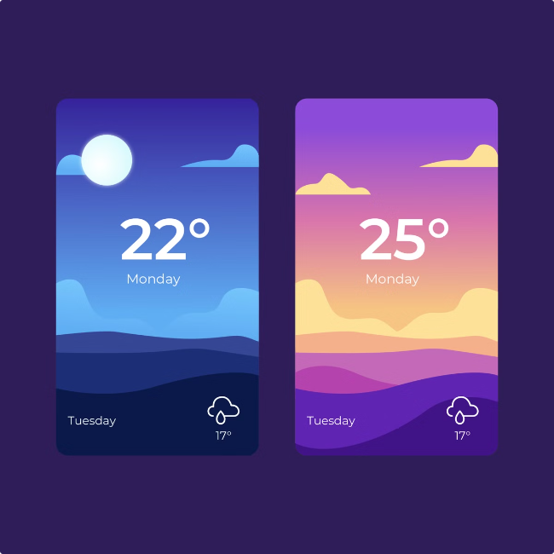
Location Input
Start by entering a location. You can use your current location or search for a specific city or zip code.
Current Location
The app automatically detects your location using your device's GPS.
Search by City
Type the name of a city in the search bar. For example, "New York City" or "London."
Search by Zip Code
Enter a valid zip code for more precise weather information.

Slide 3

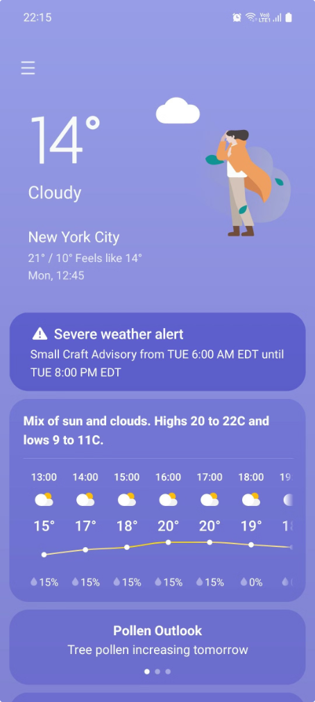
Weather Data Retrieval
Once you've entered a location, the app will fetch weather data from a reliable weather API.
1
API Request
The app sends a request to the weather API with your location.
2
Data Processing
The weather API retrieves relevant weather information for your chosen location.
3
Data Display
The app receives the processed weather data and displays it on your screen.

Slide 4

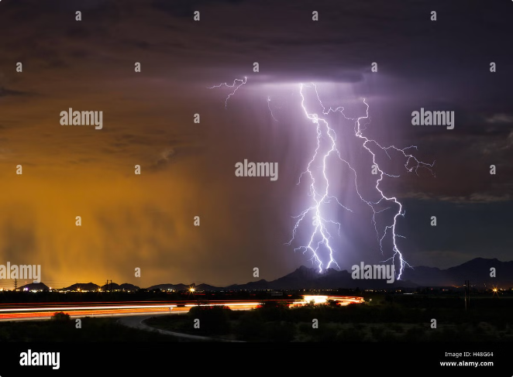
Current Weather Conditions
The app displays a clear and concise summary of current weather conditions.
1
Temperature
The current air temperature, measured in Fahrenheit or Celsius.
2
Weather Description
A detailed description of the weather, such as "Sunny," "Partly Cloudy," or "Heavy Rain."
3
Wind Speed and Direction
The wind speed and direction, providing information about the wind's strength and movement.
4
Humidity
The level of moisture in the air, indicating how dry or humid it is.

Slide 5

Additional Weather Information
Beyond the current conditions, the app offers valuable additional weather information.
Hourly Forecast
Daily Forecast
UV Index
A detailed hourly breakdown of weather conditions for the next 24 hours, including temperature, precipitation, and cloud cover.
A daily forecast for the next several days, offering insights into temperature trends, precipitation chances, and potential weather events.
A measure of the intensity of ultraviolet radiation from the sun, helping you protect your skin from harmful rays.

Slide 6
HTML STRUCTURE
<!DOCTYPE html>
<html>
<head> <title>Weather App</title>
<link rel="stylesheet" href="style.css">
</head>
<body> <div class="container">
<input type="text" id="city-input" placeholder="Enter city">
<button id="search-btn">Search</button>
<div id="weather-data">
</div>
</div>
<script src="script.js"></script>
</body>
</html>

Slide 7

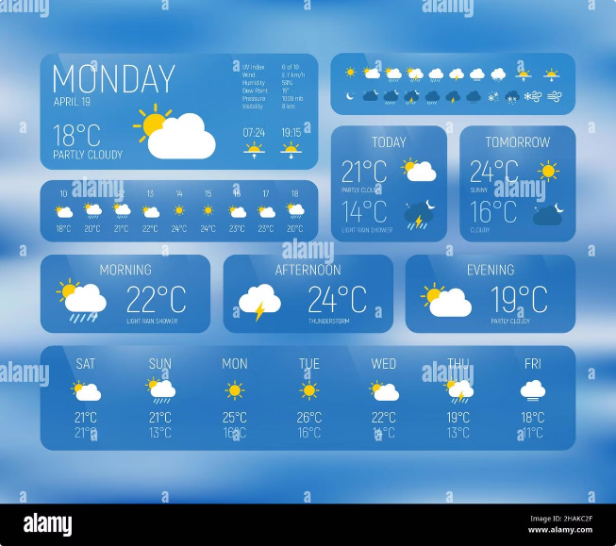



Personalized Features
The app aims to personalize your weather experience with useful features.
Weather Alerts
Receive notifications for severe weather events, such as thunderstorms, heavy rain, or snowstorms.
Customizable Units
Choose your preferred units for temperature (Fahrenheit or Celsius) and wind speed (mph or km/h).
Favorite Locations
Save your frequently checked locations for quick and easy access to weather updates.

Slide 8
CSS STYLING…
/* Basic styling, customize as desired */
.container {
text-align: center;
margin: 20px;
}
#weather-data {
margin-top: 20px;
}

Slide 9

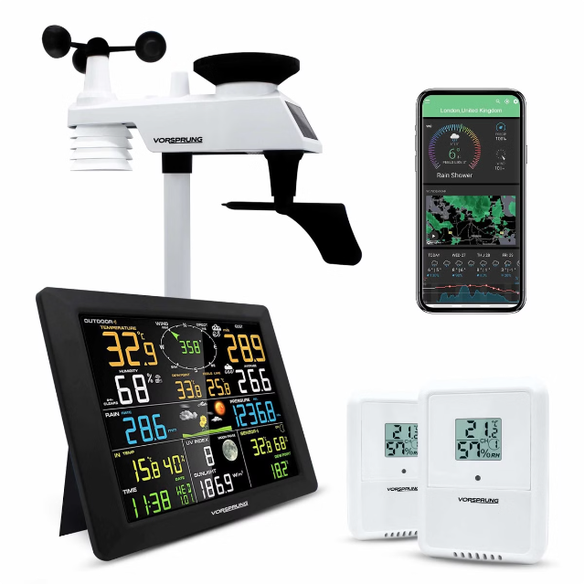
User Interface
The app prioritizes a user-friendly and intuitive interface.
Clear and Concise Layout
Easy-to-read fonts and colors ensure a smooth user experience.
Interactive Maps
Visualize weather conditions across regions, allowing you to explore weather patterns.
Intuitive Navigation
Simple controls and menus make it easy to access all weather information.

Slide 10


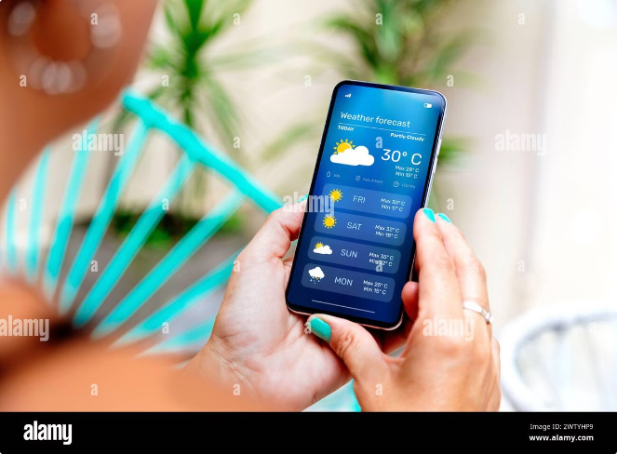



Benefits of Using a Weather App
Stay informed and prepared for any weather conditions with the help of a reliable weather app.
Plan Ahead
Plan your activities and dress appropriately based on accurate weather forecasts.
Safety Awareness
Receive timely alerts for severe weather events, ensuring your safety.
Travel Preparation
Prepare for your trips with accurate weather information for your destinations.
Enjoy the Outdoors
Make the most of outdoor activities with up-to-date weather insights.

